Slide 1
INDUSTRIAL EMPLOYMENT AND POPULISM IN GERMANY
By: Genesis Gil

Slide 2
KEY
POINTS
Introduction
Research Problem
Theory
Hypothesis
Data & Method
Results
Conclusion
01
02
03
04
05
06
07

Slide 3
1.
INTRODUCTION
Populism is increasing across Western democracies
Industrial jobs have declined since the 1970s
Leads to right-wing populism
Deindustrialisation is often linked to political dissatisfaction
Many regions affected by industrial decline are seen as “left-behind place”
Higher unemployment
Lower incomes
Loss of public services
Economic change affects not only income but also social status and identity
Fear of future decline may be as important as actual decline
Germany is a useful case due to strong regional differences in industrial development

Slide 4
RESEARCH
PROBLEM
1
Limited evidence: Industrial decline often assumed as a key driver of populism. Few studies to actually test this directly. Evidence is inconsistent.
2
Unclear mechanisms: We don’t know how or why one thing leads to another. (Economic hardship, fear, status anxiety, etc.)
3
One-sided focus: focuses mainly on right-wing populism and ignores responses from left-wing populist.

Slide 5
THEORY
TWO TYPES OF ECONOMIC CHANGE
01
02
Actual Decline
Looming Decline
Loss of industrial jobs
Unemployment
Income loss
Economic insecurity
Demand for welfare and redistribution
Fear of future job loss
uncertainty
status anxiety
perceived social decline
Concern about identity and status

Slide 6
4.
HYPOTHESIS
H1
H2
Regions where industrial jobs have already disappeared are more likely to vote Die Linke (left)
AfD (right) is stronger in regions where industry is still important.

Slide 7
DATA & METHOD
400 German regions
1970-2021
Key variables compared:
Job decline
Historical industry
Outcome ⟶ measure voting:
AfD & Die Linke
Method:
Generalized Linear Model (GLM)
Controls:
Unemployment, education, age, inequailty

Slide 8
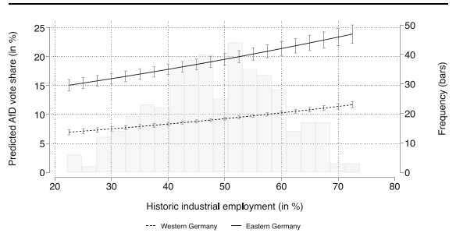
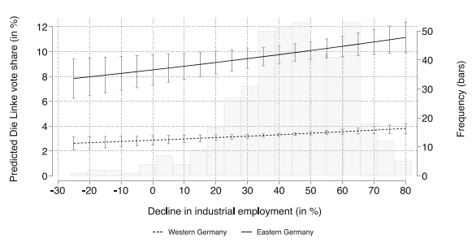
6.
RESULTS
Historical industrial
Increases AfD support
Does NOT increase Die Linke support
Industrial decline
Does NOT increase support for the AfD.
Increases support for Die Linke

Slide 9
CONCLUSION
This paper shows that industrial decline does not lead to one single political outcome. Instead, it depends on how people experience economic change. Real job loss increases support for left-wing populism, while fear of future decline increases support for right-wing populism. This highlights the importance of distinguishing between different types of economic change when explaining populist voting.

Slide 10
THANK
YOU

